Slide 1
Tea Kettle Whimsy Fest 2014

Slide 2
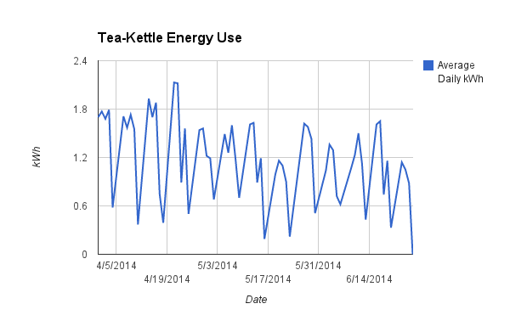
Everybody’s Working for the Weekend
Baseline Energy Use:
Weekday: 1.38 kWh
Weekend: 0.46 kWh
Annual: 439.6 kWh
Notes:
Like an efficient refrigerator.

Slide 3
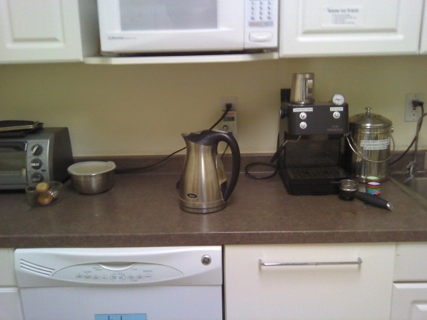
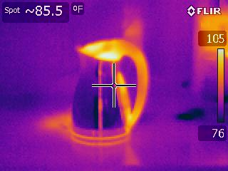
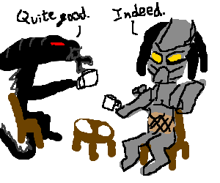
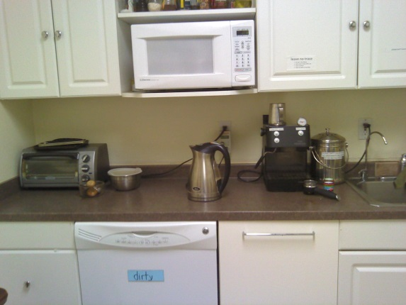
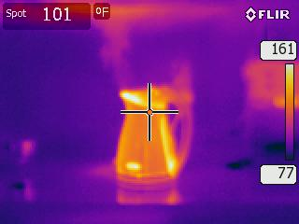
This poor tea-kettle has no idea what’s about to happen.
Thermal imaging showed significant temperature loss

Slide 4
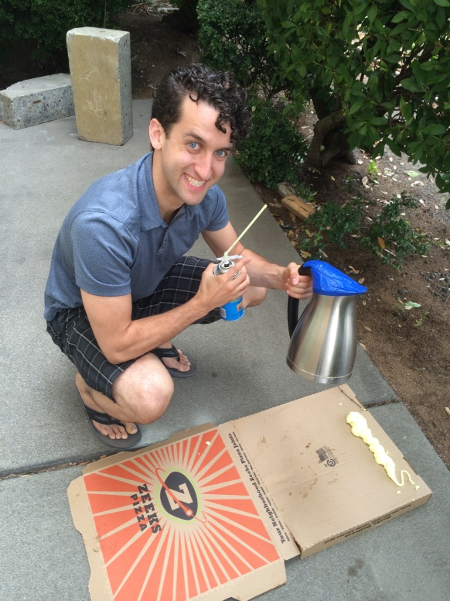
A villain appears
Little known fact: tea-kettles love pizza.

Slide 5
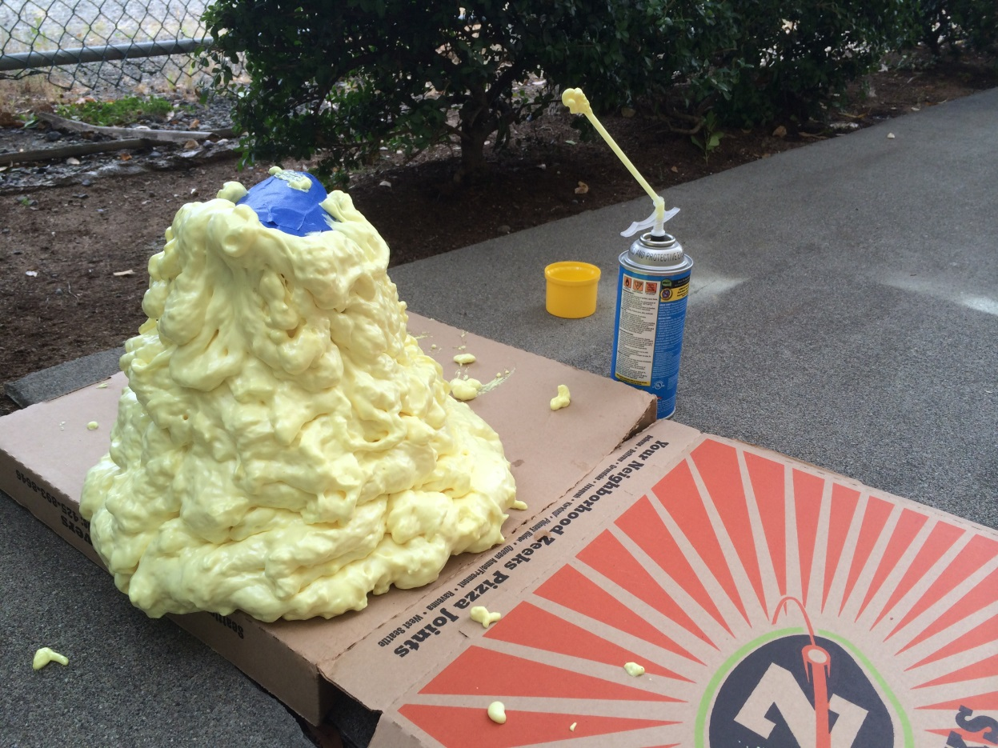
“I’ve become a monster!”

Slide 6
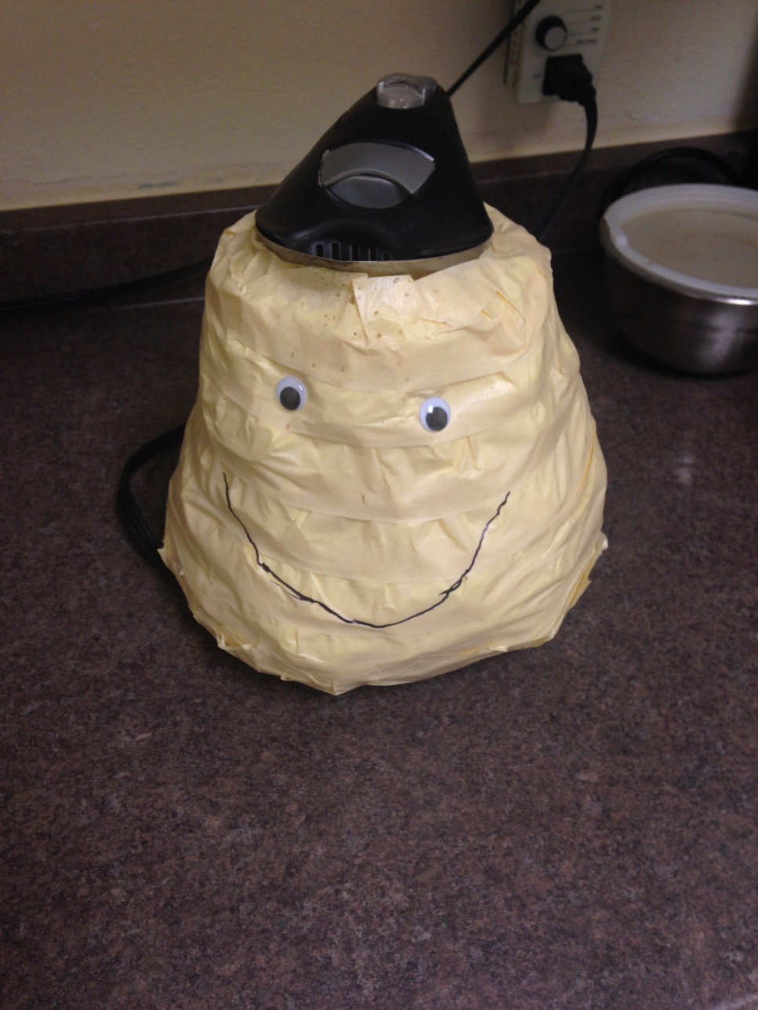
“This ain’t so bad”

Slide 7
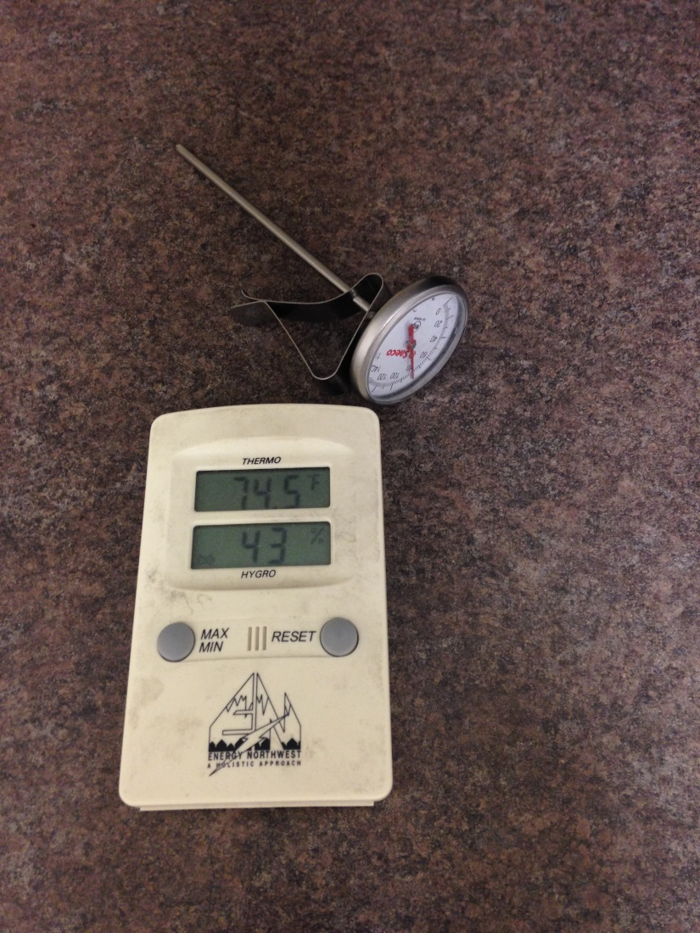
Better, Stronger, Faster
Out-of-box heat loss rate: .7097 W/F
Insulated heat loss rate: .5847 W/F
Determined using highly sophisticated equipment.

Slide 8
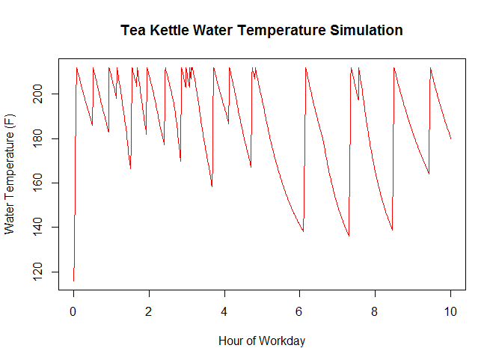
Weekday Modelling Assumptions
There is a 50% chance standby mode will be left on overnight.
Ecotope employees drink 12 oz of hot beverages at a time.
Ecotope employees use the tea kettle more in the morning then taper off throughout the day (much like a log-normal distribution).
There is a 50% chance the tea kettle will be reheated regardless of current temperature.
If there is less than 12 oz of water in the kettle someone will fill and boil it.

Slide 9
Monte-Carlo Simulation results
Uninsulated tea-kettle:
With standby option, uses 326.5 kWh/yr from weekdays
Without standby option, uses 300.8 kWh/yr from weekdays
Fabulous tea-kettle:
With standby option, uses 295.1 kWh/yr from weekdays
Without standby option, uses 259.6 kWh/yr from weekdays
Switching from an uninsulated tea-kettle with standby to an insulated tea-kettle without standby lowers Ecotope’s EUI by .085, 0.11 if we scale to account for weekend use.

Slide 10
Standby Mode, Am I Right?
If an uninsulated tea kettle is left alone for 30 minutes after boiling:
With standby mode active it will take 1:35 minutes to re-boil from 179 (F)
With standby mode off it will take 2:00 minutes to re-boil from 169 (F)
If an insulated tea kettle is left alone for 30 minutes after boiling:
With standby mode active it will take 1:15 minutes to re-boil from 186 (F)
With standby mode off it will take 1:45 minutes to re-boil from 175 (F)

